Slide 1
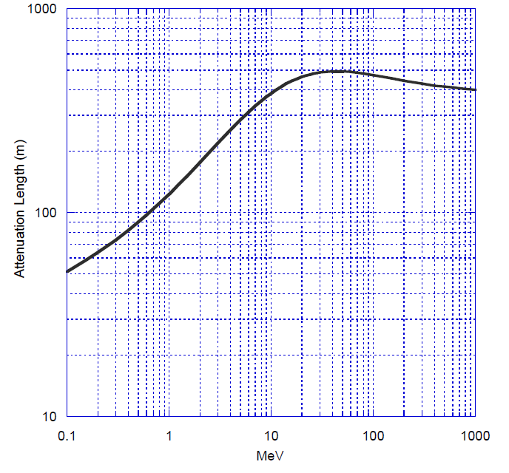
Range of photons and protons in air
Photons
Protons
Photons attenuate exponentially, protons do not

Slide 2
Why high energy photons?
Photon ranges in air are sizeable, low attenuation in air
Penetrating in target of interest
Relatively “simple” and robust source
Neutron sources tend to be isotropic and fall off quickly with 1/r²
Other types of inspection may be possible
Explosives
Chem/Bio

Slide 3
The nuclear carwash: interrogation with neutrons
Notes:
One of the most extensively tested systems using a deuteron RFQ accelerator to produce neutrons in a D2 gas target. Detectors are large arrays of plastic scintillator.

Slide 4
Neutron sources for active interrogation
Common neutron sources in active nondestructive interrogation are
(1) spontaneous fission sources, for example ²⁵²Cf
(2) (alpha,n) sources, such as Am-Li, Am-Be sources
(3) photoneutron (gamma, n) sources, utilizing either radioactive isotopes such as an Sb-Be source, or an electron accelerator with a neutron converter
(4) reactions from accelerated charged particles, for example (d,d), (d,t), (d,n), and (p, n) reactions
Photoneutron sources produce neutrons whose energies can be adjusted by varying the energy of the incident photons. Similarly, the energy of neutrons from (p,n) or (d,n) reactions can be adjusted by using different materials as the target. The neutron energy can also be modified by adding materials between the interrogation source and the sample, to either cutoff low energy neutrons, or slow down high energy neutrons.

Slide 5
Delayed neutron detection
Advantages of using delayed over prompt neutrons for detection
can be distinguished from source neutrons and photoneutrons using time discrimination
the value and the temporal behavior of the delayed neutron yield vary significantly, allowing distinguishing between the nuclear materials

Slide 6
Associated particle imaging (1)
use coincidence between gammas and alpha particles detected to image object
detect alpha particles on position-sensitive detector
timing of gammas: distance to object
effective electronic collimation method

Slide 7
Associated particle imaging (2)
Limitation of APM: random coincidence rate
once neutron is emitted, must wait to detect (or not detect) gamma-ray until the next neutron is produced
Example: 100 ns between neutron production and detection
cannot exceed ~10⁶ n/s sent towards the target
depending on solid angle select the neutron generator rate (typically 10⁷ - 10⁸ /s)
best: low-current, highly focused beam

Slide 8
Associated particle imaging (3)
Alpha particle transducer for API
use scintillation coating
average light output of 20 photoelectrons per event

Slide 9
Compact neutron generators (1)
Reactions of interest:

Slide 10
Compact neutron generators (2)
Y. Wu, et al. Rev. Sci. Instrum. 81, 02B908 (2010)
2x10⁵ n/s (DD) with RF power of 150 W, an acceleration voltage of 75 kV, and an acceleration column pressure of 4.5 mtorr
- expect 100x yield with DT

Slide 11
Active detection of shielded SNM with 60-keV neutrons (1)
C. Hagmann, et al. IEEE TNS 56, 1215 (2009)
- detect prompt emission of high energy (>1 MeV) neutrons
- induces fission in fissile, but not fissionable nuclei
detected 376 g of shielded ²³⁵U in ~1 min
efficacy of detections depends on shielding (hydrogenous or non-hydrogenous)
neutron source

Slide 12
Active detection of shielded SNM with 60-keV neutrons (2)
C. Hagmann, et al. IEEE TNS 56, 1215 (2009)
Threshold: 1.88 MeV
- strongly forward directed neutron emission; no need for side shielding
Background:
1) hard gamma from ⁷Li(p,n) + photonuclear reaction in surrounding material
2) ⁷Li(p,alpha)⁴He followed by ⁴He(⁷Li,n)¹⁰B
- total contribution ~10⁻⁵ per low-energy neutron
- gammas can Compton scatter in detector mimicking neutrons

Slide 13
p-⁷Li source
Beam energy distribution

Slide 14
Expected signal

Slide 15
Measured signal
- 96 cylindrical scintillator cells; total active area ~1 m²
- use PSD (gamma rejection ~10⁻³)

Slide 16
Beta-delayed gammas following fission for SNM detection
E.B. Norman, et al., Nucl. Instum. Methods A 521, 608 (2004). - examine gammas ≥3 MeV
- increase in sensitivity by 10³-10⁴ compared to detection of delayed neutrons
- high yield compared to neutrons (~x10)
- excellent transmission through hydrogenous materials

Slide 17
The Nuclear Car Wash: delayed fission gamma-ray detection (1)
D.R. Slaughter, et al. Nucl. Instrum. Methods B 241, 777 (2005)
interrogation with a pulsed beam of 7 MeV neutrons
detect beta-delayed neutron emission or beta-delayed high-energy gamma radiation between beam pulses
require ~1 min for inspection
detectors loaded with Gd to detect beta-delayed neutrons in addition to gammas

Slide 18
The Nuclear Car Wash: delayed fission gamma-ray detection (2)
130 s interrogation
standard 20 ft container
4x10¹⁰ n/s
380 g 93% HEU near cargo centerline
¹⁶O(n,p)¹⁶N
(10 MeV threshold)
Decay of gamma radiation at energies above 3 MeV for a 130-s interrogation cycle
delayed gamma detection approximately 10⁴ times more sensitive than delayed neutron detection

Slide 19
Why use protons for active interrogation
Proton mean free path is large
Proton transmission is large
Intermediate energy proton fission cross sections are large
Result is that we produce large numbers of neutrons
These neutrons induce more fission events
Dense shields such as Pb and W also produce neutrons and increase fission rate
Protons provide dose amplification in the target: 1 neutron/30MeV
Delayed neutrons or gammas are unique to fission
What are the reasons against using protons for active interrogation?

Slide 20
Simple estimates
Calculate proton range through air and beam diameter at target from scattering
Target is 4 kg U inside 5 cm W
Projected area ~ 36 cm²
Beam energy after W determines yield/proton in U
Calculate p/cm²/s
Note critical dose issue:
5×10⁸ protons/100 cm² is 400 mrem

Slide 21
Example 1
500 MeV protons through100 m of air
Beam diameter (FWHM) at 100 m ~ 1.0 m
Mean energy after 5 cm of W is 308 MeV.
Proton current of 10 µA
number of protons is 10⁻⁵ x 6 x 10⁺¹⁸ ~ 6 x 10¹³ p/s
Flux = 7.6 x 10⁹ p/cm²/s
On target = 2.7 x 10¹¹ p/s
Simple spallation yields 2.7 x 10¹² n/s.

Slide 22
Example 2
2 GeV protons through 2000 m of air
Beam diameter (FWHM) at 2000 m ~ 22.8 m
Mean energy after 5 cm of W is 1.43 GeV.
Proton current of 10 μA
Number of protons is 10⁻⁵ x 6 x 10⁺¹⁸ ~ 6 x 10¹³ p/s
Flux = 1.5 x 10⁷ p/cm²/s
On target = 2.7 x 10¹¹ p/s
Simple spallation yields 5 x 10⁸ n/s
Yield/p is lower due to target thickness
May want to increase current to 100 μA

Slide 23
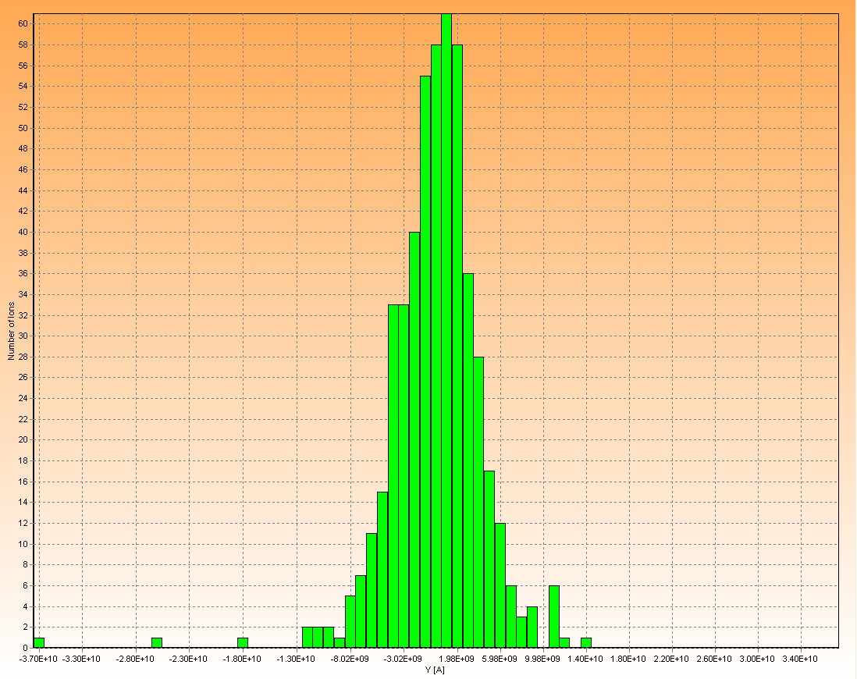
Proton beam spread - size
500 MeV beam at 100 m
1.0 m FWHM (0.1 m bins)
2 GeV beam at 2000 m
22.7 m FWHM (1.0 m bins)

Slide 24
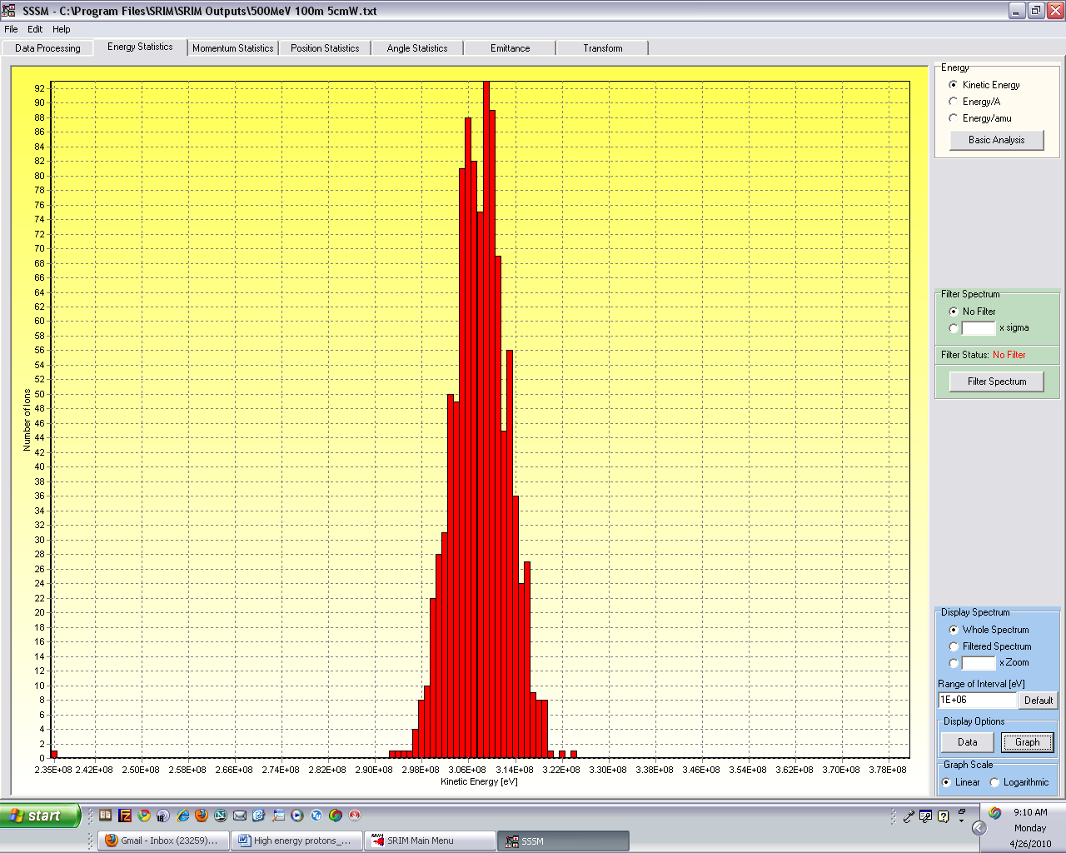
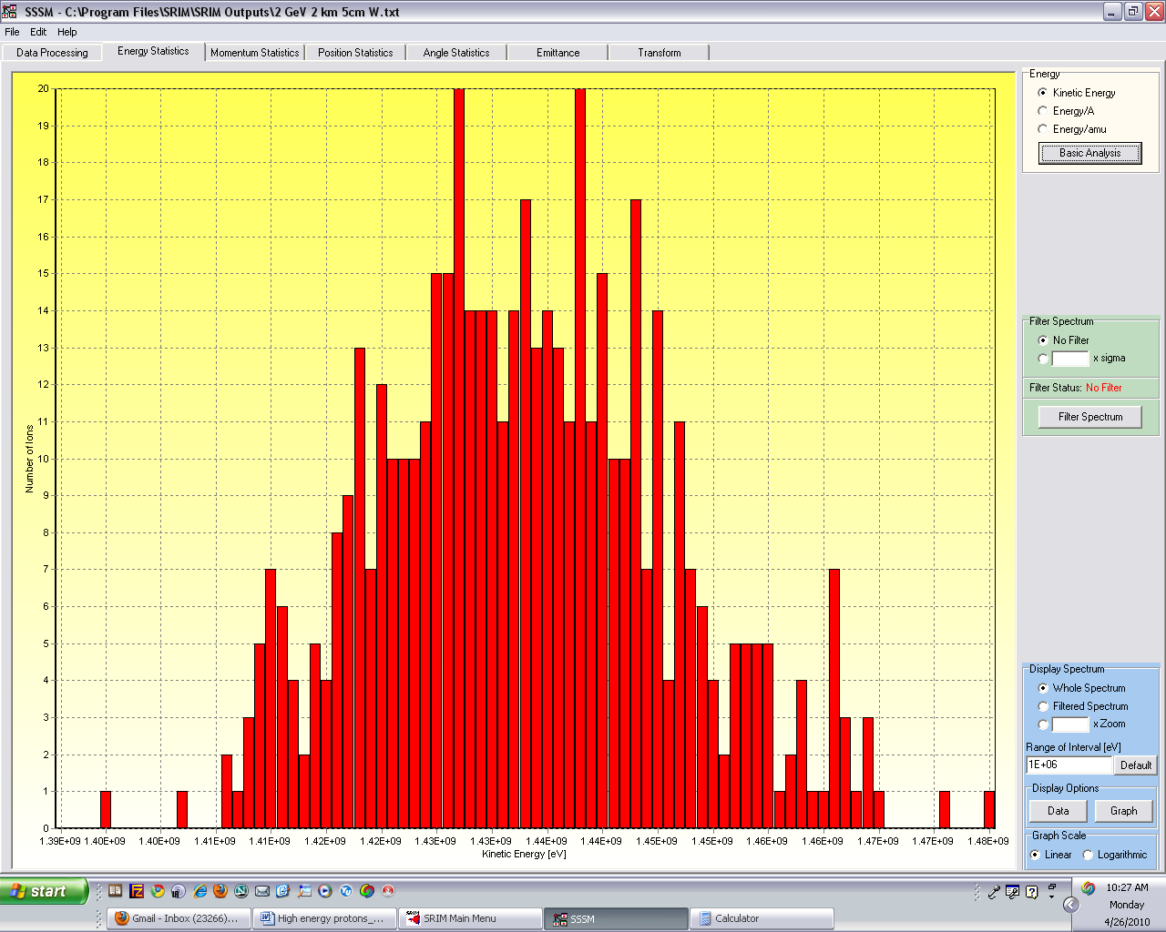
Proton beam spread - energy
500 MeV beam after 100 m air, 5 cm W:
308 MeV (FWHM 12 MeV - 1 MeV bins)
2 GeV beam after 1000 m air, 5 cm W:
1.43 GeV (FWHM 100 MeV - 1 MeV bins)

Slide 25
Neutron energy distribution at distance
For 2 MeV initial neutron energy
Energy of neutrons at detector
0.2eV - 1 keV
1-10 keV
10-50 keV
50- 100 keV
100-200 keV
200-500 keV
0.5-1 MeV
1-2MeV
Notes:
Effects of moderation, scattering etc. Graph shows flux as a function of distance out to 1200 m for the energy bins indicated at left.

Slide 26
Time of arrival as function of final energy
For 2 MeV initial neutron energy
Energy of neutrons at detector
0.2eV - 1 keV
1-10 keV
10-50 keV
50- 100 keV
100-200 keV
200-500 keV
0.5-1 MeV
1-2MeV
Notes:
Neutron arrival time at detector as a function of distance for the energy bins at left. Note low energy neutrons arriving at tens of ms.

Slide 27
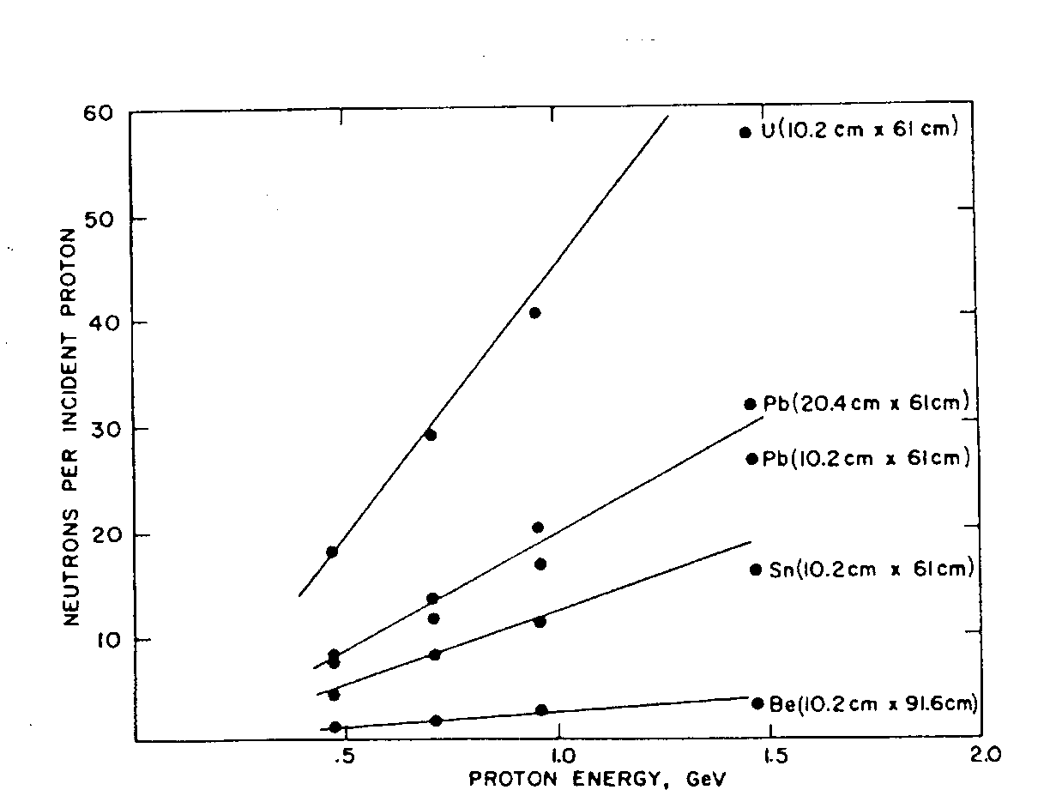
Proton probe signatures
Spallation neutron yields are large with U target
~45 n/p at 1 GeV incident
Notes:
Note that spallation neutrons are produced in most materials, but in U the yield is high, and effect is magnified and delayed by induced fission.

Slide 28
Proton probes
The general idea of the proton probe is to look for neutrons >1 MeV from fission after the prompt fast neutrons have subsided
Model of the correlation between energy and time for neutrons produced by a proton beam in iron to illustrate the concept
Notes:
Upper figure is a frequency plot showing the total population of neutrons (all energies) at various times (1 ns up to tenths of a second). Lower figure shows how various energy neutrons are distributed in time. Where fission occurs, the characteristics of these plots will be different.

Slide 29
Proton produced delayed neutrons
Note significant difference with fissile material
Proton beam at 800 MeV

Slide 30
Proton-induced delayed neutron characteristics
Delayed neutrons( >4sec) signal fission
Overburden (shielding, other cargo) increases signal
Borated poly reduces signal

Slide 31
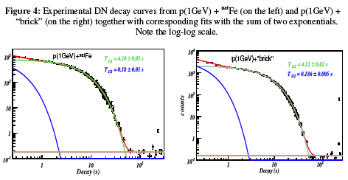
Problem with proton-induced delayed neutron signature
Fission fragments emit energetic delayed neutrons, enhancing the signature mechanisms. This is well-studied.
On the other hand, structural materials can be activated by energetic protons and also emit energetic delayed neutrons. This is not so well-studied.
D. Ridikas, et al., Proceedings of PHYSOR2006, Vancouver, Canada, 10-14 Sept. 2006

Slide 32
Proton-induced delayed gamma measurement
Notes:
Note enhancement of gamma production from U.

Slide 33
Neutron induced delayed gammas
Gammas penetrate cargo and hence can be detected externally
Little spectral information so do not need good energy resolution detectors
Use neutrons below 10 MeV to eliminate gammas from the¹⁶O(n,p)¹⁶N reaction
Notes:
Key points: delayed gamma intensity below that of neutrons, but penetration may be decided in actual cargo situation
Low-cost, large plastic detectors can be used

Slide 34
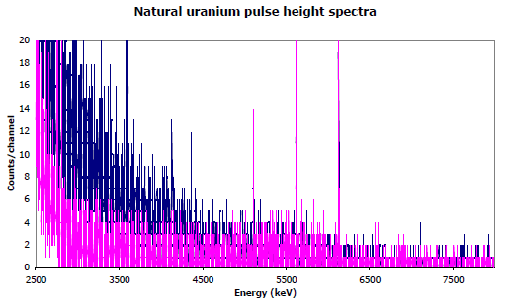
Delayed gammas energy spectrum
natural uranium
background
¹⁶O(n,p)¹⁶N lines
Notes:
Note that the nitrogen lines are for neutron energies > 10 MeV so this is an argument for not using a 14 MeV DT generator. The lines are full energy and single and double escape peaks.

Slide 35
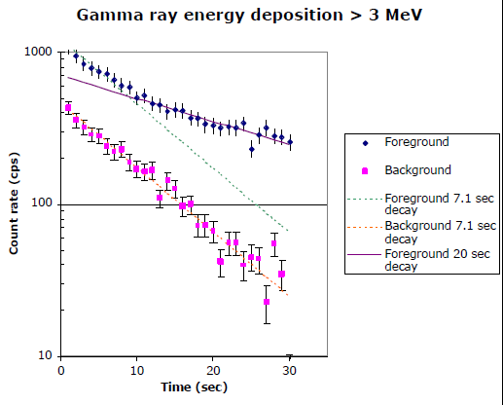
Delayed gammas from neutron interrogation
Notes:
Foreground = with U, Background = without U

Slide 36
Summary of the “big three” source characteristics
Particle | Production | Penetration | Particle Source Shielding | In-beam Dose Rate | Signature
Photons | Easy | Good | Easy | Low
Protons | Easy | “Spallation Advantage” | Easy | High | “Spallation Advantage”
Neutrons | Difficult | Good+ | Difficult | Medium
*Penetration for all particles is dependent on shielding/target environment. In high Z shields protons produce spallation neutrons, which also produce signature radiation, tending to counteract shield losses. Protons also produce very high neutron yields in U and Pu, enhancing neutron signatures.

Slide 37
Accelerator produced muon interrogation
Concept:
An accelerator produces muons
Muons captured by target nucleus
Decay of muon produces characteristic gamma rays
Extreme penetration: high signal for low dose
Scenario:
Ship-to-ship interrogation
“Bistatic detection” with UAV neutrons and gamma detectors
Issues:
Muon production rate
Muon interaction rate
System integration
Objective: Stand-off detection of ²³⁵U at >100m
Computed Spectrum of K Muonic X Rays in U-235 and U-238
U-238
U-235
Counts
6000
6100
6200
6300
6400
6500
6600
Energy (keV)
n_{m}
n_{f}
mX-ray
n_{m}
m⁻
5cm Pb 10cm U 5cm Pb

Slide 38
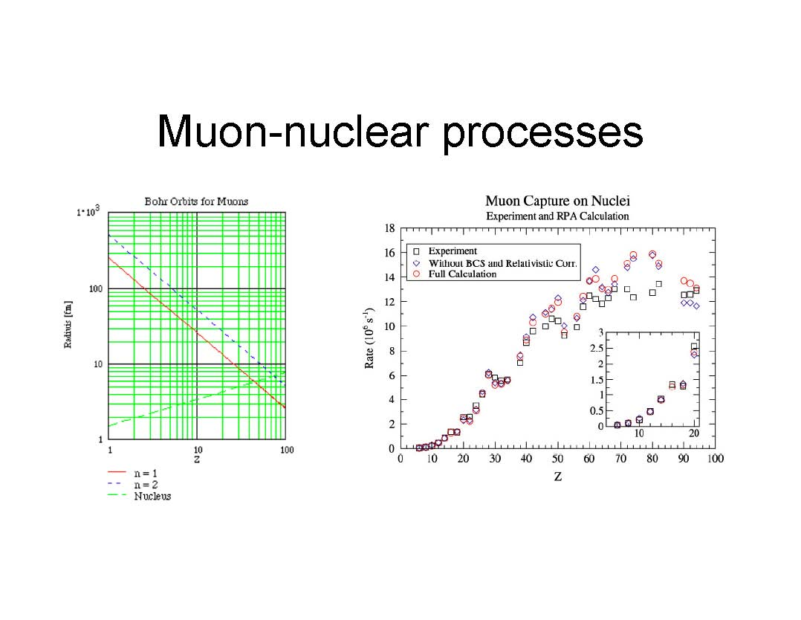
Muonic X-rays
Muons are heavier cousins of the electron. They have a lifetime of about 2 μs.
In the Bohr model, the orbits of a μ⁻ in an atom of charge Z are characterized by
r_{n} = n² a₀/(Z² m_{μ}/m_{e})
E_{n} = n⁻² Ry (Z² m_{μ}/m_{e})
where a₀ = 0.5 x 10⁻¹⁰ m and Ry = 13.6 eV.
For U and Pu, (Z² m_{μ}/m_{e}) ~ 2 x 10⁶, so the orbits are tiny and the transition energies are large.
Note that for Z>10, the μ⁻ spends a lot of time in the nucleus.

Slide 39
Muon capture
The downside of the μ⁻ spending so much time in the nucleus is muon capture
Muon decay, via μ⁻ -> e⁻ + ν_{e} + ν_{m}, would not produce an onerous background
But for Z>10, capture via μ⁻ + p -> n + ν_{m} becomes dominant. This produces energetic neutrons, which in turn produce copious high energy gammas

Slide 40
Active interrogation: conclusions
Active interrogation is likely to be the only practical long distance detection approach
Protons have greater range and produce larger signals than either photons or neutrons
Time delayed signals are clear characteristic of fission events
Technology is available but deployable systems still need improvement and demonstrations

Slide 41
References
Title image credit: http://cdsweb.cern.ch/record/1345733
”Taking a Gander with Gamma Rays”, LLNL S&T Review, December 2006
B. D. Soane, ”Dual Energy Gamma-ray Transmission for Coincident Measurement of
Water Content and Dry Bulk Density of Soil”, Nature 214, 1273-1274 (1967)
Nuctech radiography inspection system, http://www.nuctech.com
J. R. Lamarsh, “Introduction to Nuclear Engineering”, 2nd ed., Addison-Wesley,
Reading, MA (1983)
J. K. Shultis and R. E. Faw, “Fundamentals of Nuclear Science and Engineering”,
Second Edition, CRC Press, 2007.
W. Niemann, S. Olesinski, T. Thiele, ” Detection Of Buried Landmines With X-Ray
Backscatter Technology”, 8th ECNDT, Barcelona, June 2002.
http://www.ndt.net/article/ecndt02/96/96.htm

Slide 42
References
M. Gmar, et al., ”Assessment of actinide mass embedded in large concrete waste
packages by photon interrogation and photofission”, Applied Radiation and Isotopes
63, 613–619 (2005)
Passport Systems, Inc. http://www.passportsystems.com/
M. S. Johnson, D.P. McNabb, ”Using Nuclear Resonance Fluorescence to Isotopically
Map Containers”, http://inpp.ohiou.edu/~SNP2008/talks/Johnson_M.ppt
W. Bertozzi, et al.,” Nuclear resonance fluorescence and effective Z determination
applied to detection and imaging of special nuclear material, explosives, toxic substances
and contraband”, Nucl. Instrum. Methods B 261, 331 (2007)
F. Albert, et al., ”Isotope-specific detection of low-density materials with laser-based
monoenergetic gamma-rays”, Opt. Lett. 35, 354-356 (2010)
J. Pruet, et al., ” Detecting clandestine material with nuclear resonance fluorescence”,
J. Appl. Phys. 99, 123102 (2006)

Slide 43
References
”Screening cargo containers to remove a terrorist threat”, LLNL S&T Review, May 2004
J.M. Hall, et al., ”The Nuclear Car Wash: Neutron interrogation of cargo containers
to detect hidden SNM”, Nucl. Insrum. Methods B 261, 337-340 (2007)
D. S. Koltick, et al., ”Characterization of an Associated Particle Neutron Generator
With ZnO:Ga Alpha-Detector and Active Focusing”, IEEE Trans. Nucl. Sci. 56, 1301 (2009)
Y. Wu, et al., ”Sealed operation of a rf driven ion source for a compact neutron generator
to be used for associated particle imaging”, Rev. Sci. Instrum. 81, 02B908 (2010)
C. Hagmann, et al., ”Active Detection of Shielded SNM With 60-keV Neutrons”,
IEEE Trans. Nucl. Sci. 56, 1215 (2009)
E. B. Norman, et al., ”Signatures of fissile materials: high-energy g rays following fission”,
Nucl. Instrum. Methods A 521, 608 (2004)

